Slide 1
Salary Predictor
Explore Employee Salaries and Job Roles Across Industries

Slide 2
Purpose of the Project
Are you curious about forecasting your upcoming salary?
Are you interested in having a benchmark to guide your negotiation efforts?
The Salary Predictor will help you answer those questions and more!
Follow through to understand how this tool works and how can you use it…

Slide 3
The Dataset
The only way to make good predictions is to have a good Dataset
The one we chose include:
11 columns and 3300 rows
Data from over 70 countries all around the world
Employees job title, experience level, employment type and residence
Information about year, remote ratio and company size
WHERE EVERYTHING BEGINS

Slide 4

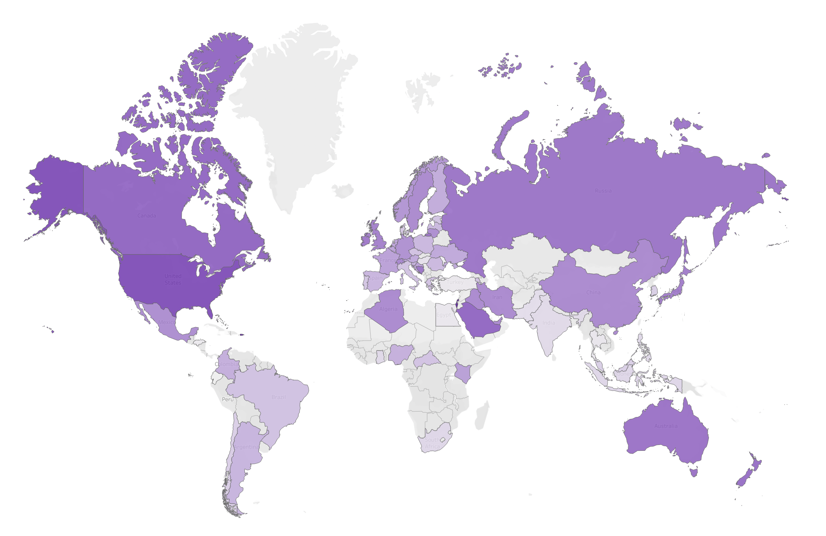
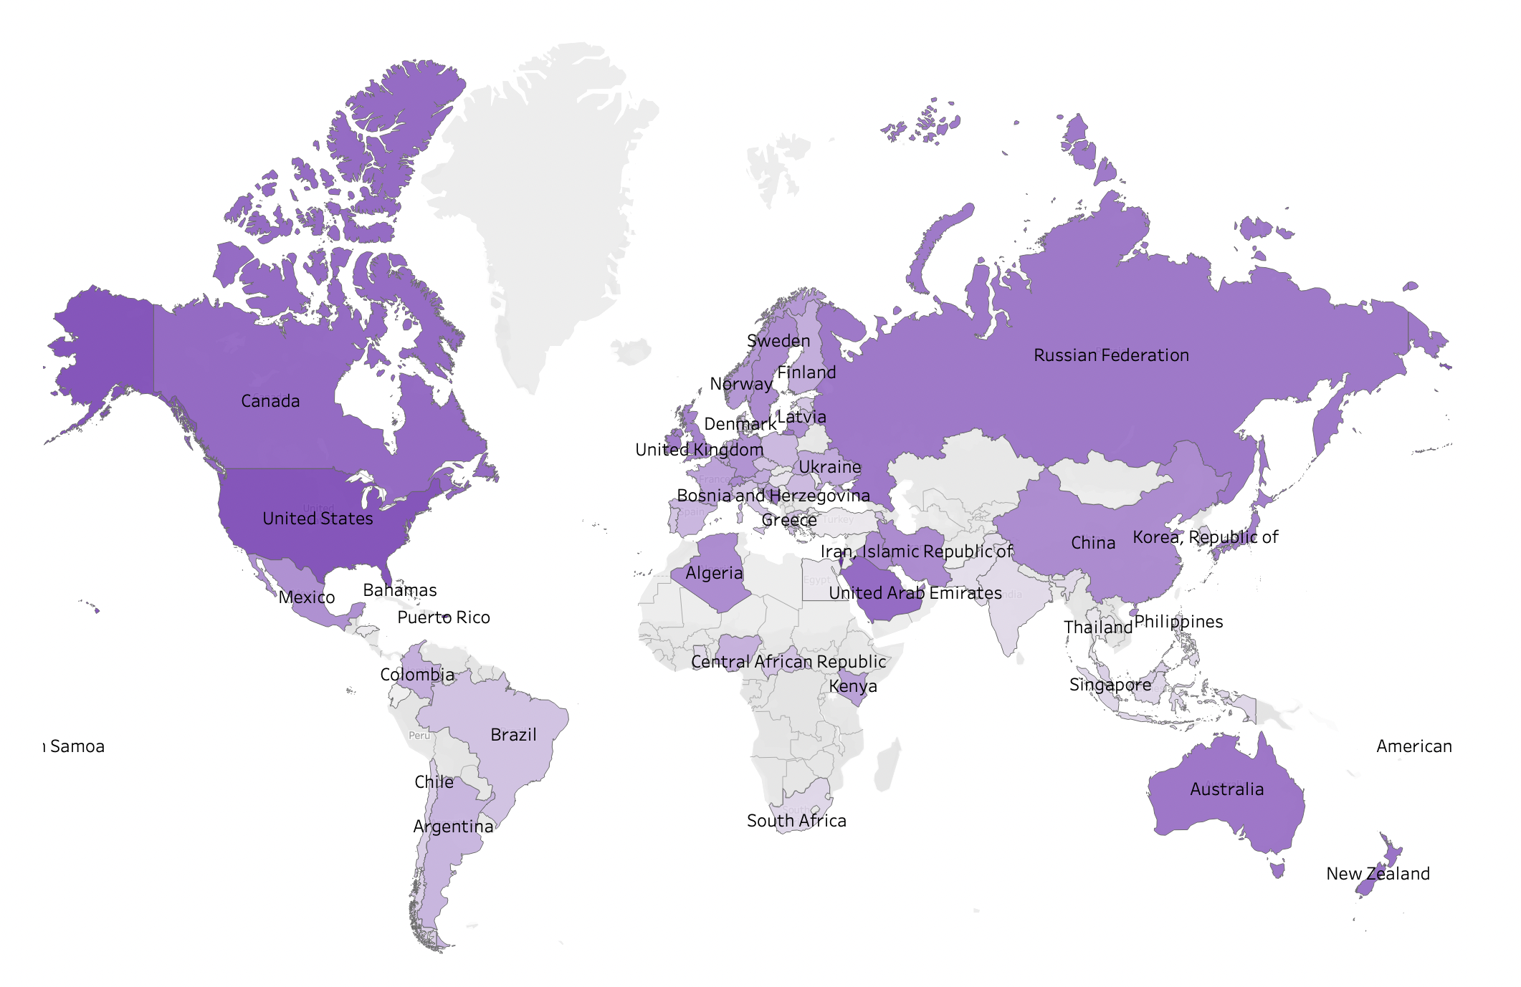
Average Salary
in each Country

Slide 6
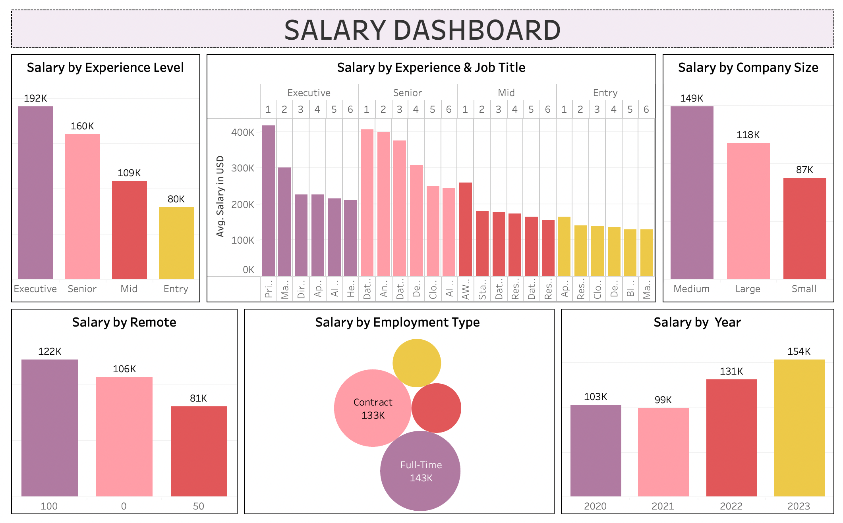

Slide 7
DEMO
↑ CLICK and try it yourself ↑

